Slide 1

Department of Information Technology
NBA Accredited A.P. Shah Institute of Technology G.B.Road,Kasarvadavli, Thane(W), Mumbai-400615 UNIVERSITY OF MUMBAI Academic Year 2020-2021

Slide 2
A Project Report on A. I. Based Document Digitization System Submitted in partial fulfillment of the degree of Bachelor of Engineering(Sem-8) in INFORMATION TECHNOLOGY By Sujoy Dev(17104036) Rashmi Shetty(17104070) Priya Naik(17104021) Under the Guidance of Sameer Nanivadekar & Kiran Deshpansde

Slide 3
1.Project Conception and Initiation

Slide 4
1.1 Abstract
One of the challenges faced by every corporate industry is maintenance of records, mainly non-digitized type, i.e. hard copies and prints
While a few of these documents are digitized, the are some which are very crucial in nature and require high level of maintenance, such as, ration card, marks sheet, or etc. Furthermore there are billing invoices.
Storing these essential documents on a server can be a solution but, it requires manual labour and verification, which might lead to the misplacement of data during the process.
Our application can act as a maintenance provider by extracting essential data from these documents and storing them in data structures.
This system will reduce the amount of issues of traditional document maintenance which involves manual verification of data by the human eye, since once the data is extracted it can be verified and tested against a set of rules

Slide 5
1.2 Objectives
Reduce document maintenance and information retrieval efforts from documents such as invoices, purchases orders, maintenance records, etc. by developing an ecosystem by using machine learning, Computer Vision for document data identification, extraction and validation.
Gain necessary information from the documents and store the data as document format for easy storage, matching and verification of data.
Update the knowledge-base regularly to gain newer information from the documents.
Platform to train and test with newer document types.
Reduce paper dependency and go digital.
Create a cross platform web application for packaging the technology

Slide 6
1.3 Literature Review
Wei Ruan and Won-sook Lee [5], built a Named Entity Recognition medical imaging
procedure recognition system based on conditional random fields (CRF) model with word-
based, part-of-speech. The NER model has been trained on a custom annotated dataset
of medical notes from I2B2 with the F1 score up to 0.923 for recognizing medical imaging
procedure entities. This system can be used to add and recognize new entities by simply
Lu, H. et al.[1], have conceived a method to for better preprocessing of shadowed text im-
ages, for which the character recognition performance of Tesseract drops significantly. In this
paper, we propose a new method to process the shadowed text images for the Tesseract’s
optical character recognition engine. First, they performed a local adaptive thresholding to
transform the document to gray-scale image into a binary image to capture the contours of
texts. Now in order to get rid of the salt-and-pepper noise in the shadow areas they applied
a double-filtering algorithm, in which a vertical and horizontal projection method is method
is used to remove the noise between texts and after that median filter removes the noise
within characters.This type of preprocessed data when provided to Tesseract OCR produces
much better result.

Slide 7
1.4 Problem Definition
To create system for digitization and maintenance of documents. Institutions/users must be able to upload documents(expense bills etc.) and the important data from these documents must be extracted as key pair data (JSON). If the data is not extracted from the documents the users must be able to select the data themselves for training the model.
Store everything in a centralized repository.

Slide 8
1.5 Scope
Document digitization make managing, editing, creating and organizing documents easy.
Digital files can be accessed anywhere, allowing real-time collaboration on a project
Easy access to online documents

Slide 9
1.6 Technology stack
Python3 - backend, ML
NodeJs - file server
ReactJS - Client/frontend
MongoDB - Database
PM2 - Process Manage manager -

Slide 10
1.7 Benefits for environment & Society
Document digitization is useful for transactional data management ie banks, manufacturers,
Automatic Data gathering
Invoice segmentation etc.
It reduces human effort

Slide 11
2. Project Design

Slide 12
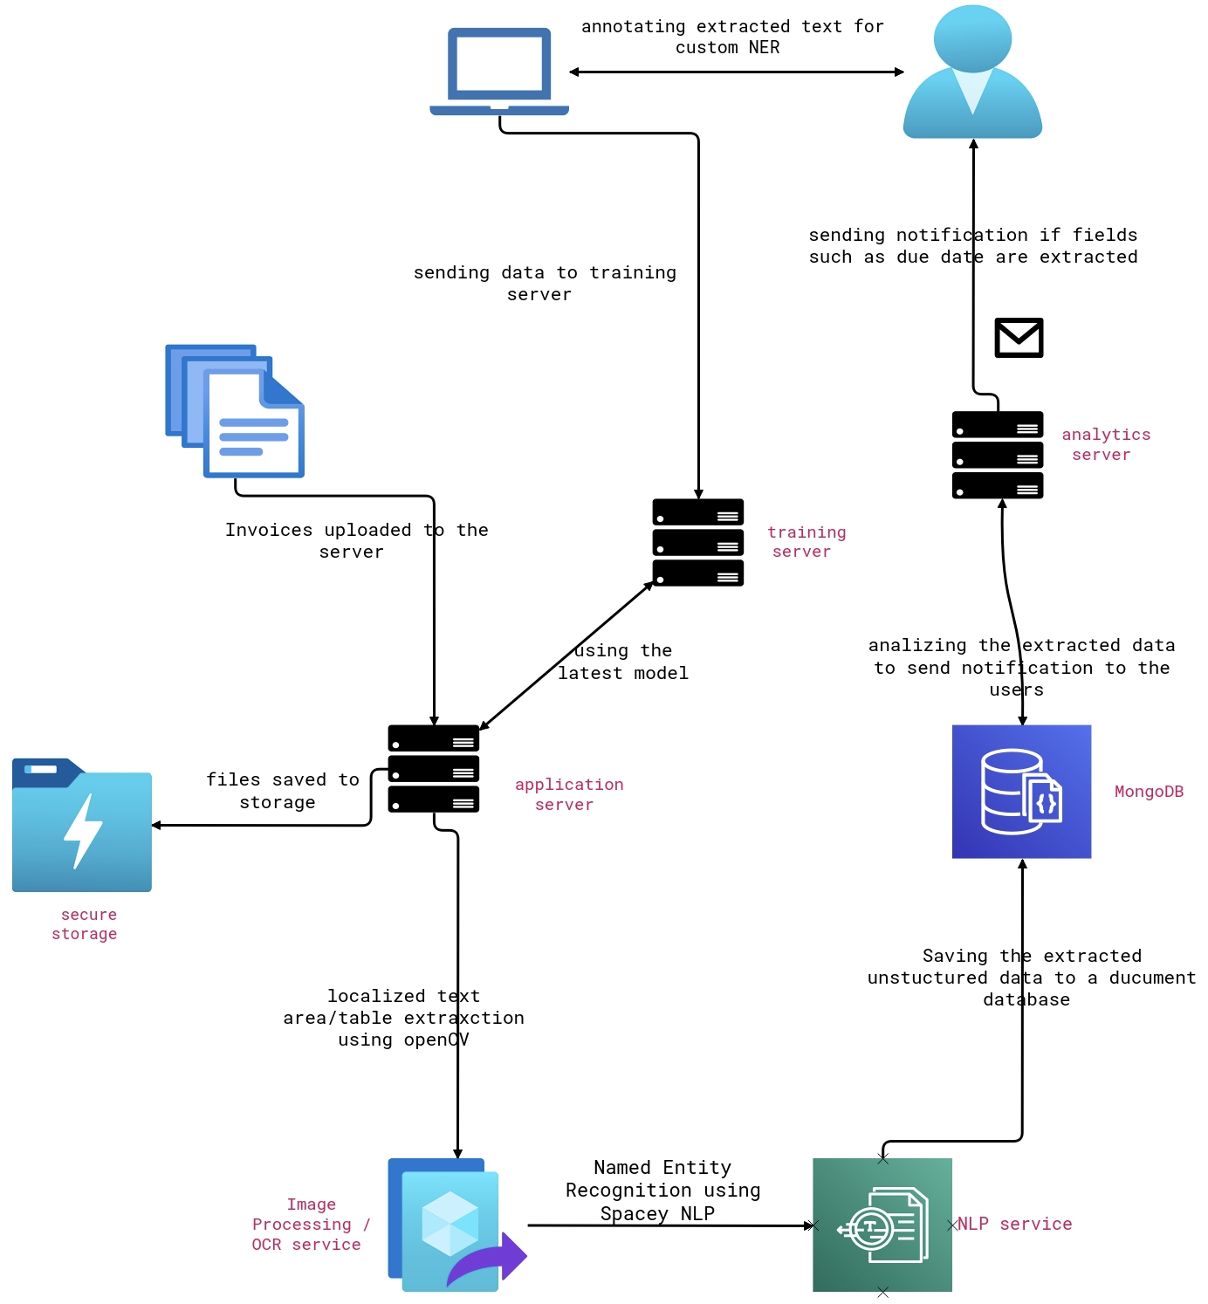
2.1 Proposed System
A multi server architecture with
Dedicated training and analytics
Server instances

Slide 13
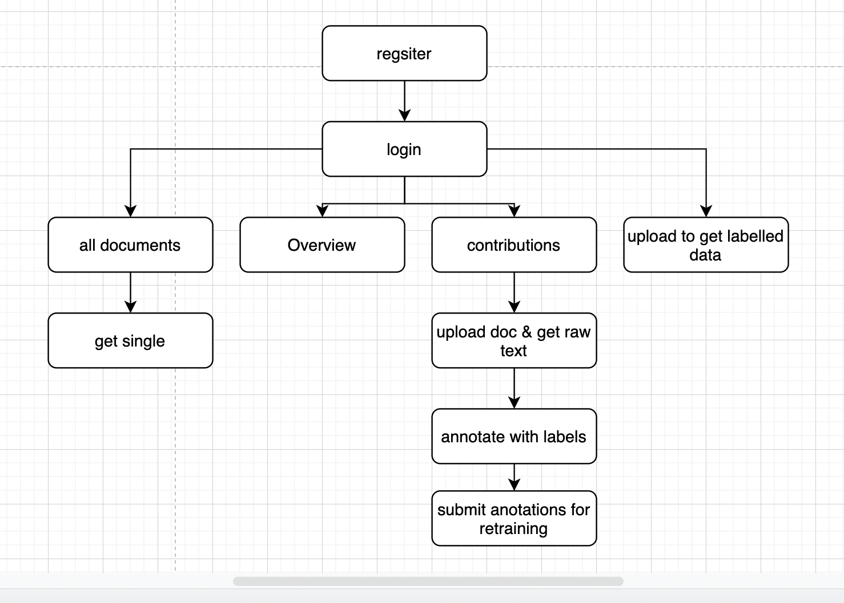
2.2 Design(Flow Of Modules)

Slide 14
2.3 Description Of Use Case
As a user i want yo extract key value pairs from documents for personal needs
I must be able login to a portal
Upload my document
Get the key value pair as output containing document metadata
If the correct data is not extracted Is must be able to teach the system about data I want

Slide 15
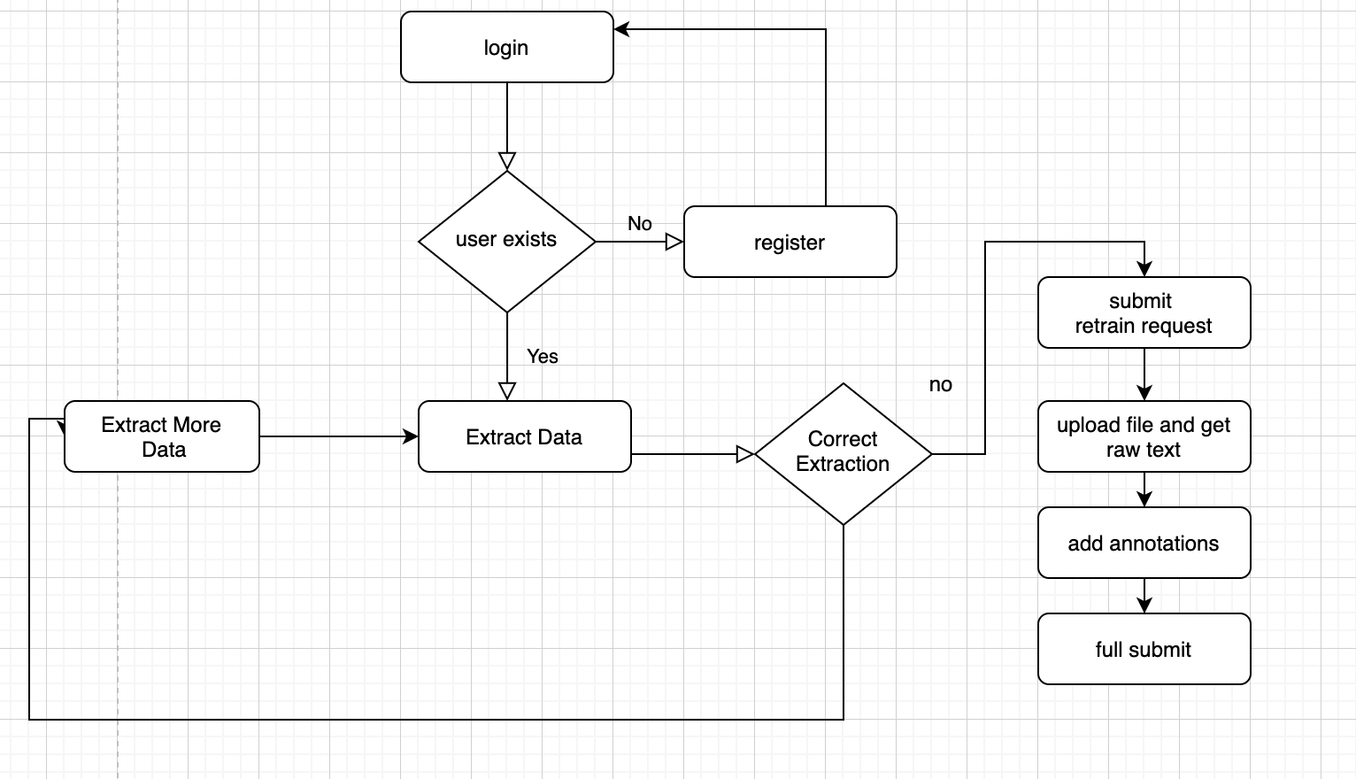
2.4 Activity diagram

Slide 16
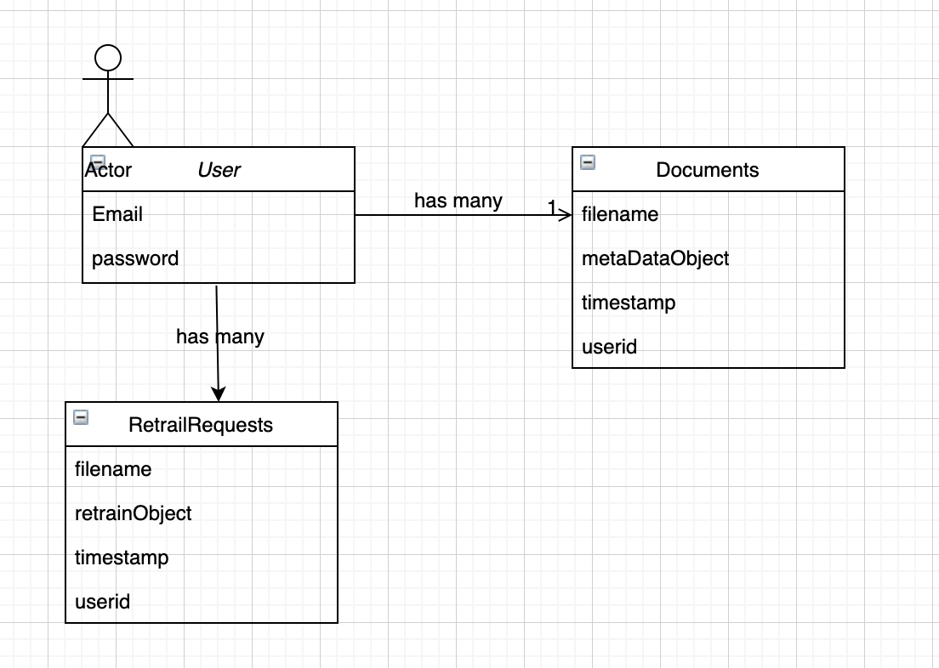
2.5 Class Diagram

Slide 17
3. Implementation

Slide 18
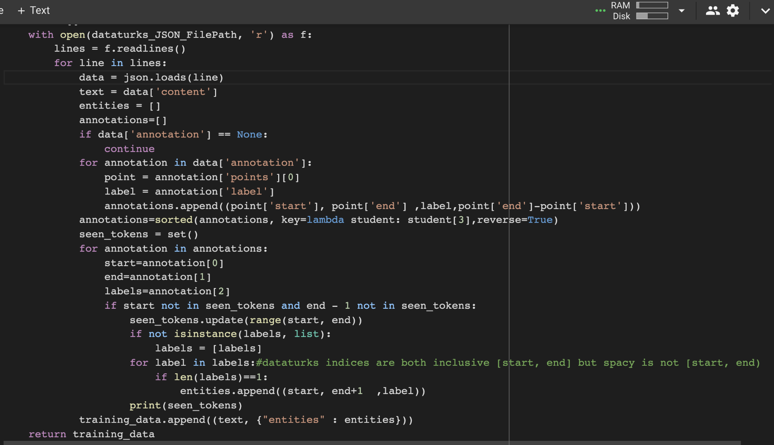
3.1 Data Validation

Slide 19
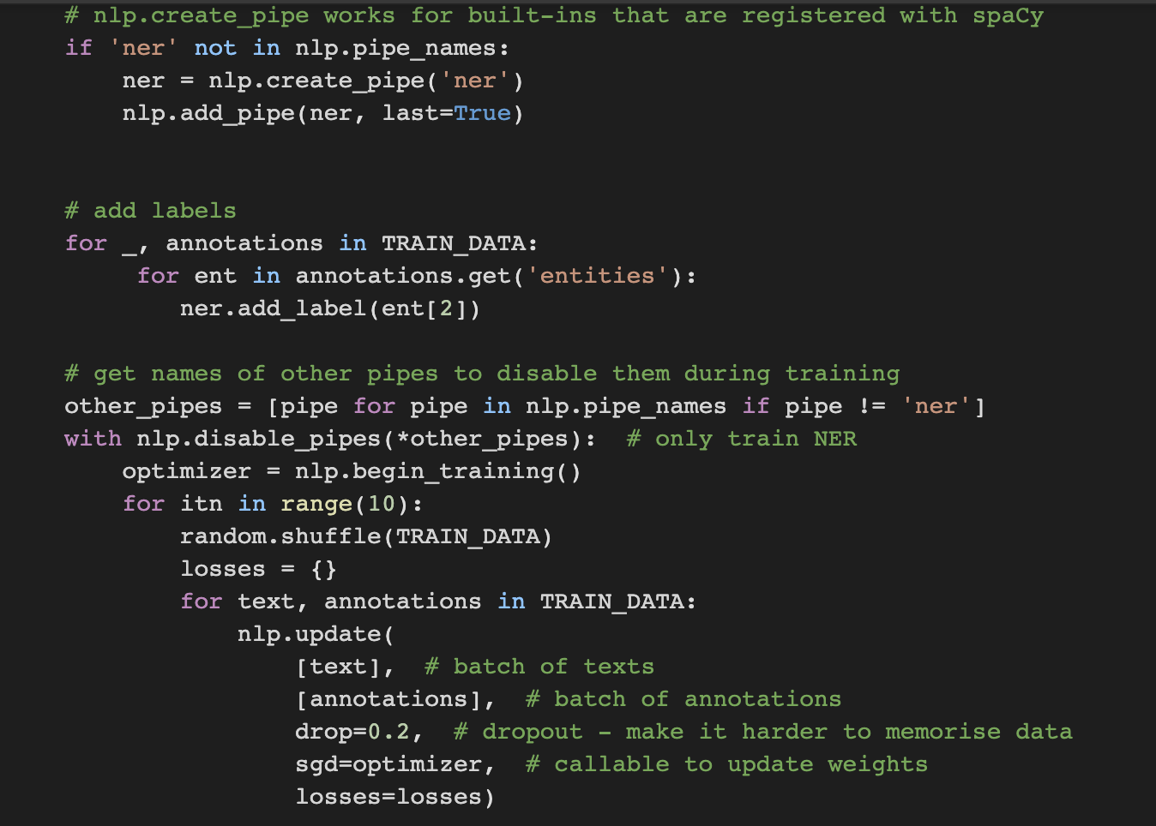
3.2 NLP update
3. Implementation

Slide 20
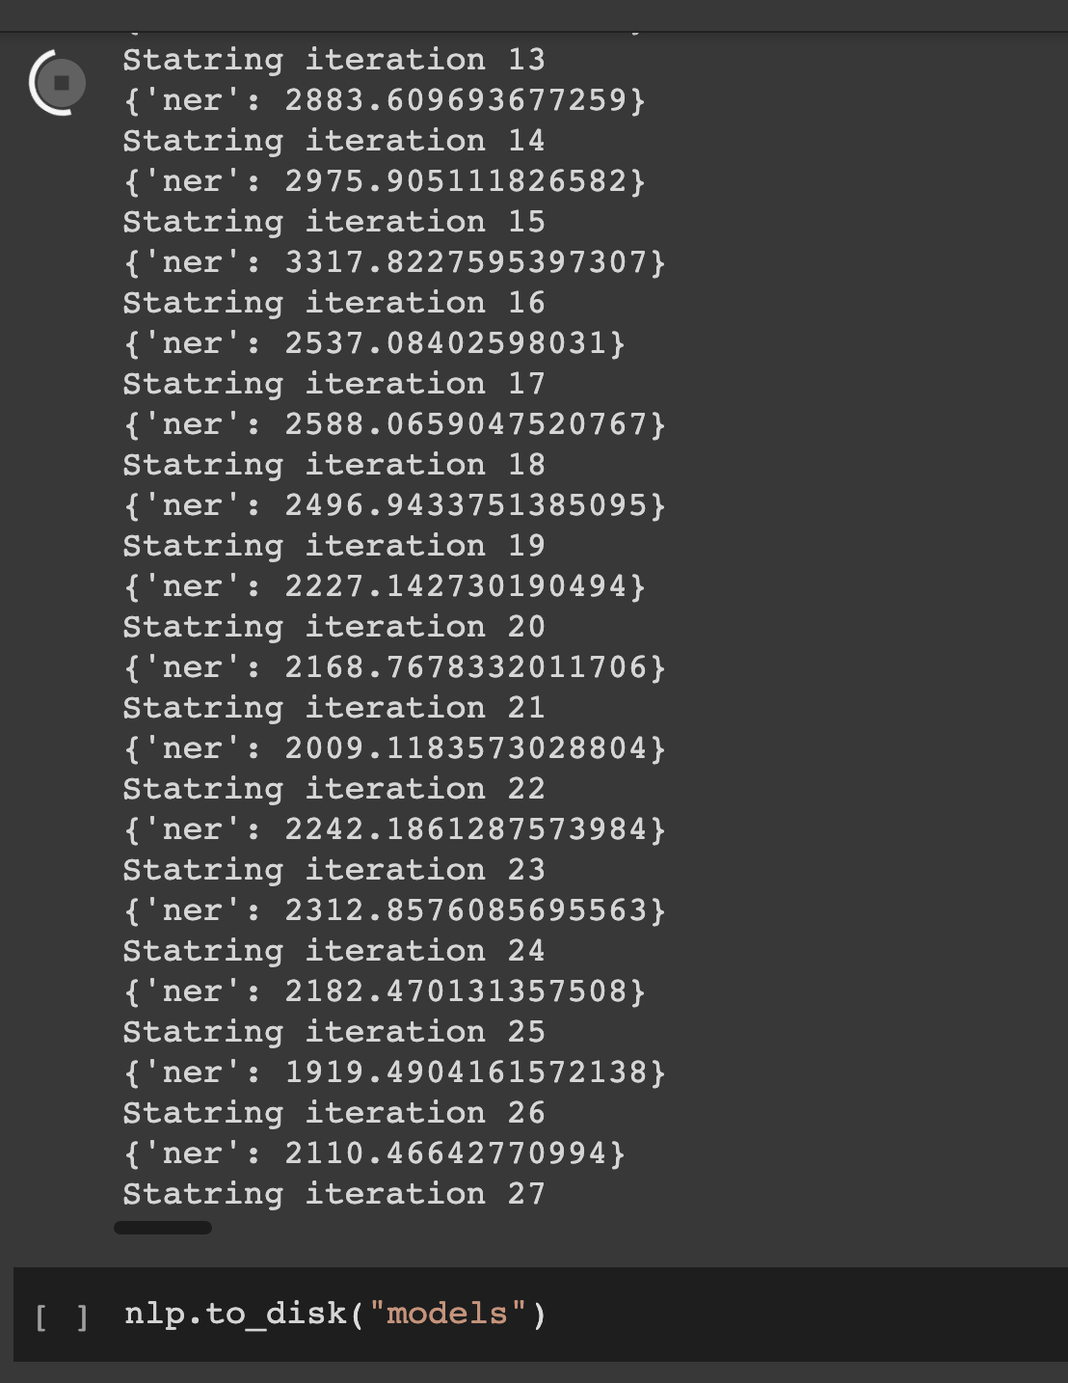
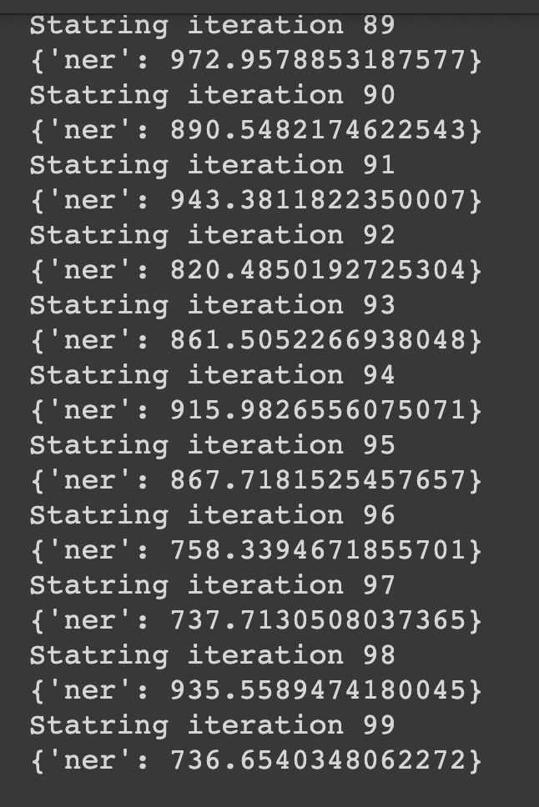
3.2 NLP update

Slide 21
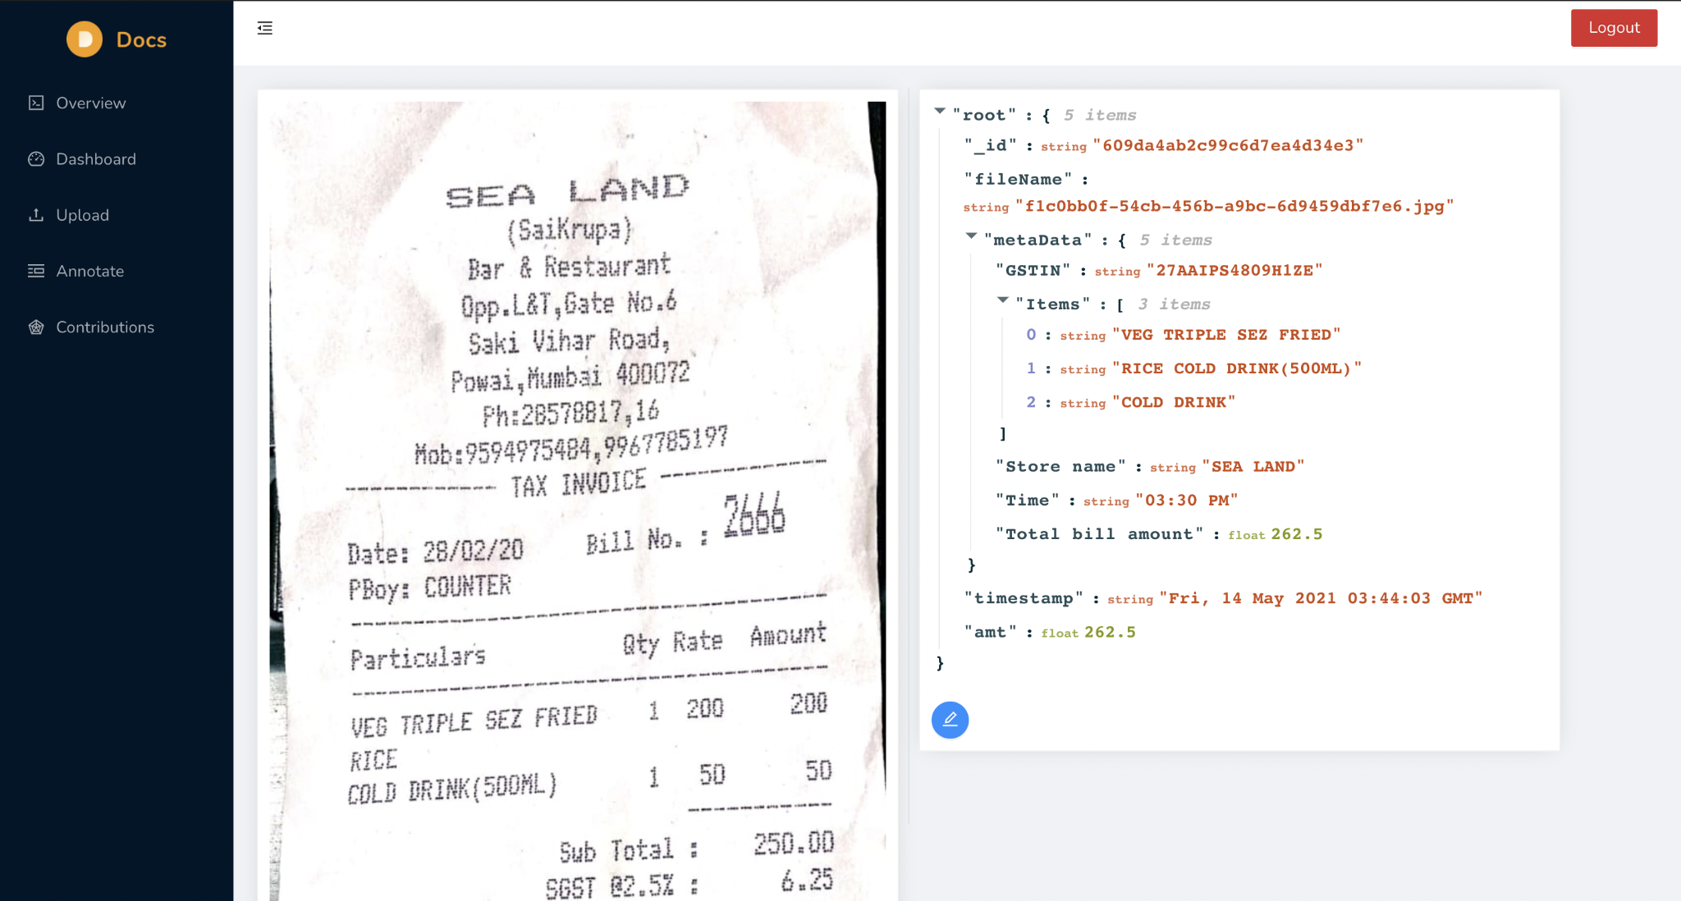
3.4 Digitization

Slide 22
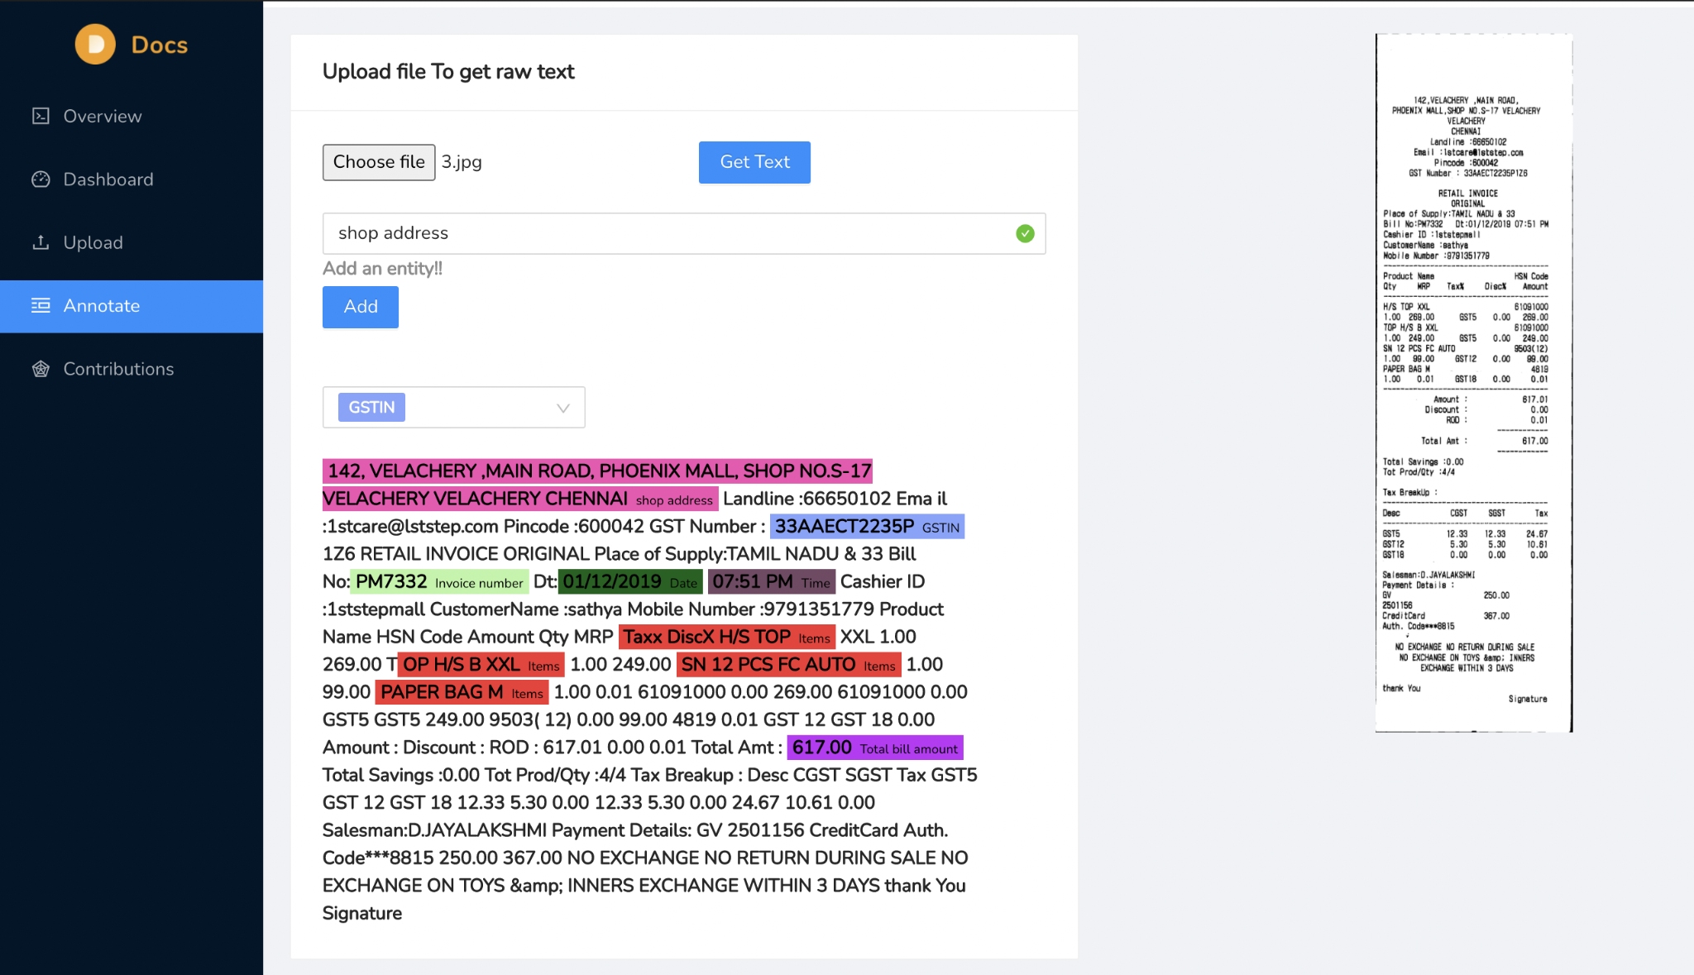
3.5 Custom Training Request

Slide 23
4. Testing

Slide 24
Client Side UI - Manual Testing to understand user experience
Backend - automated Testing to simulate API calls

Slide 25
5. Result

Slide 26
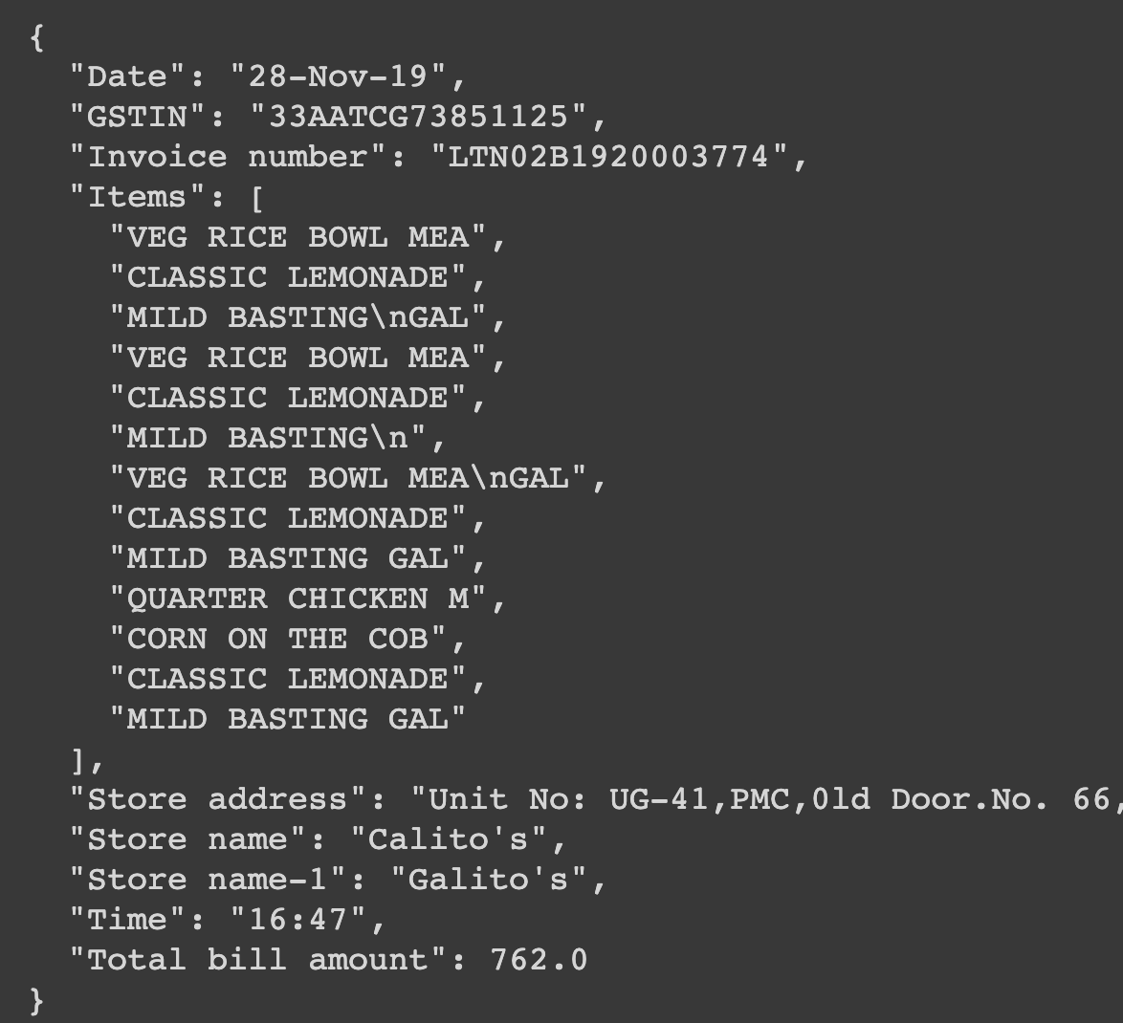
Very Large data set

Slide 27
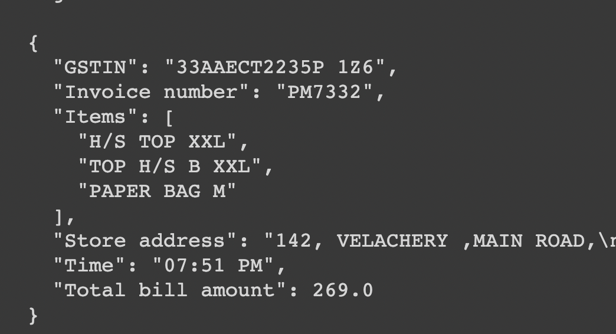
Moderate amount of data

Slide 28
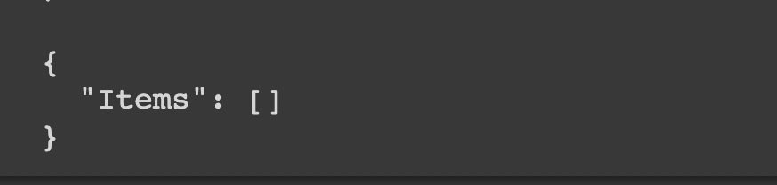
Unknown document schema

Slide 29
6. Conclusion and Future Scope

Slide 30
With the power of named entity recognition and image processing we were able build a web based application to extract key value pairs from bills and invoices. Extraction is not always effective since there are many limitations such as image quality, small datasets, non expressive data, etc. Retrain queries are mode of gathering additional data and updating the existing model wit that. Such system can take up the time consuming task of data entry and make it automated and faster. By reducing paper dependency we may be able to be truly digitized
Further with the use of templates and visual markers, template base positional data a can be implemented. A strong intermediary between the user submitted training data and the training server will be effective in filtering out invalid data, hence aiding inadata cleaning and pre-processing. Industrial invoices can be targeted with sufficient training

Slide 31
References
1] Lu, H., Guo, B., Liu, J., Yan, X. (2017).
[2] Sidhwa, H., Kulshrestha, S., Malhotra, S., Virmani, S. (2018).
[3] K.M. Yindumathi, Shilpa Shashikant Chaudhari, R. Aparna. (2020).
[4] Zhang, J., Ren, F., Ni, H., Zhang, Z., Wang, K. (2019).
[5] Wei Ruan; Won-sook Lee (2018).
[6] Internet Archive,
[7] Wikipedia, towardsdatascience, https://towardsdatascience.com/pre-processing-in-ocr-fc231c6035a7, last accessed 19.10.20
[8} Dataset, https://github.com/zzzDavid/ICDAR-2019-SROIE.git

Slide 32
Paper Publication
Paper entitled “A. I. Based Document Digitizations” is submitted at “Second International Conference on Secure Syber computing and Communications 2021” And “8th International Conference on Smart Computing Communications”

Slide 33
Thank You

